Slide 1
Atomic Symbols

Slide 2
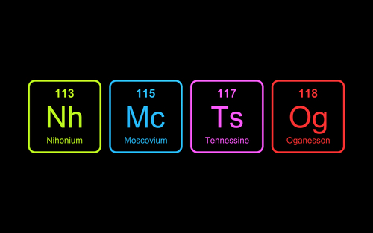
In this Smart Lesson you will learn about atomic symbols of the elements. After you have completed this lesson, you should be able to:
Identify and correctly write the unique chemical symbols for the first 20 elements and other selected elements.
Define atomic number, mass number, and relative atomic mass.
Use the periodic table to determine the number of protons, neutrons and electrons in an atom of a given element

Slide 3
The Transfermium Wars
Before a newly discovered element gets an atomic symbol, it must be named. The naming rights to a new element traditionally go to the scientist(s) who discovered the element.
However, some elements have had multiple groups claiming to be their discoverer. For example, elements 104−106 are radioactive elements discovered as a result of atomic research during the Cold War. American scientists at the Lawrence Berkeley National Laboratory, and Soviet scientists at the Joint Institute for Nuclear Research, Dubna, both claimed to have discovered these three elements.
This controversy, along with disputes surrounding the naming of 107 and 108 between the Russians and Germans, became known as the "Transfermium Wars", because the five elements follow Fermium (Fm) on the periodic table.

Slide 4
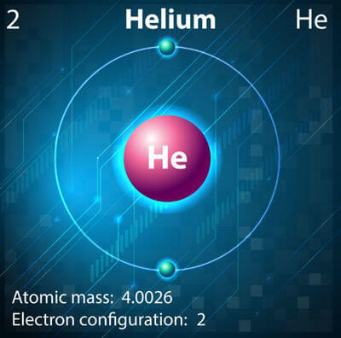
Every known element has its own unique chemical symbol.
This chemical symbol is either one or two letters derived from the name of the element.
For example, the chemical symbol for helium is He.

Slide 5
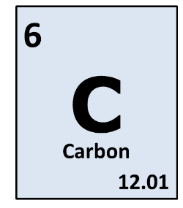
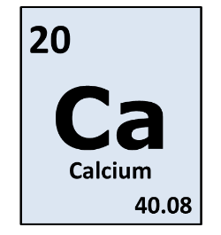
The first letter of the chemical symbol is always a capital, just like a person's name.
If the first letter already belongs to another element, a second letter is added to the chemical symbol. The second letter is always lowercase.
For example, Ca is used for calcium because C is already used for carbon. It must be written Ca and NOT CA, ca, or cA.

Slide 6
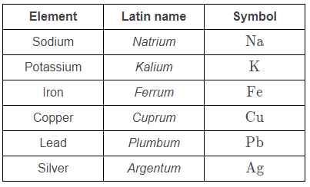
Some chemical symbols do not resemble the common name we use for the element.
For example, the symbol for silver is Ag. This is because the symbol is derived from the Latin name for silver, argentum.
Some other elements that have symbols derived from their Latin name are shown below. You will need to remember these symbols.

Slide 7
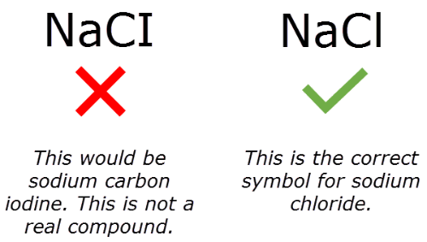
Chemical symbols are always letters. They never contain numbers.
Two symbols that students often have trouble with are oxygen and chlorine. Oxygen's symbol is a capital O. It is not a zero.
Chlorine's symbol is a capital C followed by a lowercase L (Cl). The second letter is not a 1 or a capital I.
You will be marked wrong if you type the incorrect symbol.

Slide 8
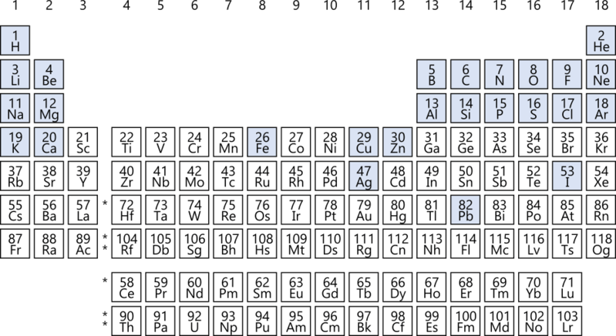
All 118 elements are organised on the periodic table. They are ordered from left to right in terms of increasing atomic number (number of protons in the nucleus).
You need to know the first 20 elements (H to Ca) plus Fe, Cu, Zn, Ag, I and Pb. These are all highlighted below in blue.

Slide 9
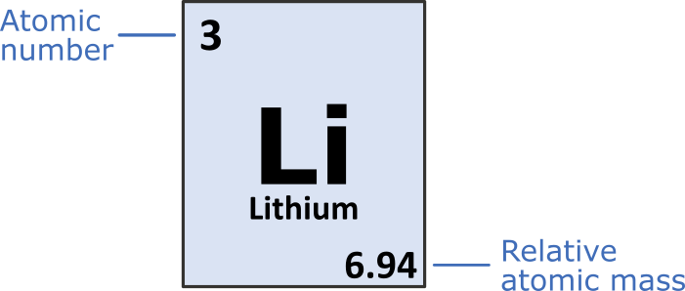
The periodic table contains a series of boxes with important information about each of the elements.
There are two numbers in each element's box: the atomic number and the relative atomic mass.

Slide 10
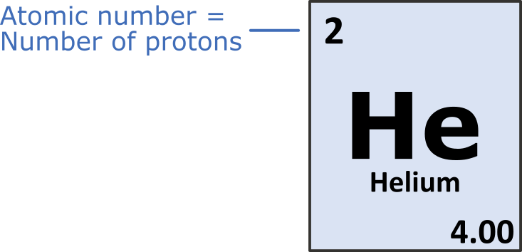
The atomic number is equal to the number of protons in the nucleus.
The atomic number is what distinguishes different elements from one another. It is always the smaller number in the element's box.
For example, helium's atomic number is 2. Each single atom of helium has 2 protons in its nucleus.

Slide 11
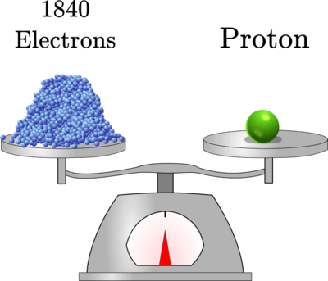
The mass number is equal to the number of protons + neutrons in the nucleus.
The mass number tells you the mass of a single atom of that element, in atomic mass units (amu). Protons and neutrons each have a mass of about 1 amu.
The number of electrons is not included in the mass number because electrons are so light that they do not significantly contribute to the mass of an atom.

Slide 12
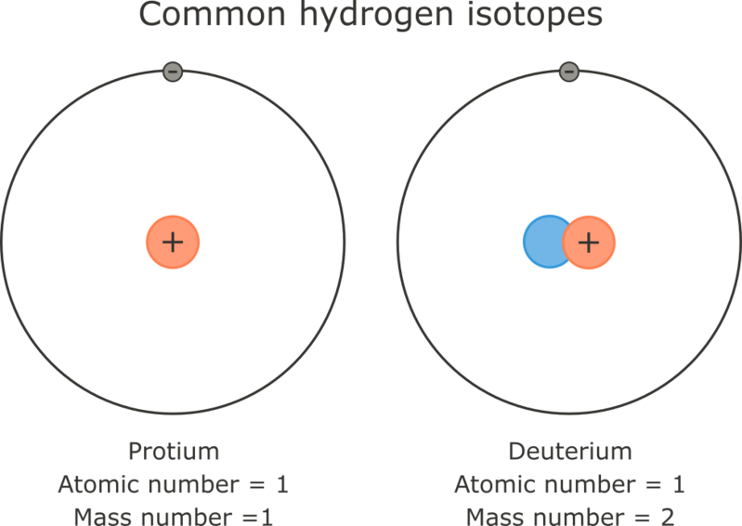
The number of neutrons in an atom of a specific element can vary.
Elements are only defined by the number of protons in their nucleus. Atoms of an element with different numbers of neutrons are called isotopes.
Both neutrons and protons contribute to the mass of an atom, so these different isotopes of the same element have different mass numbers but the same atomic number.

Slide 13
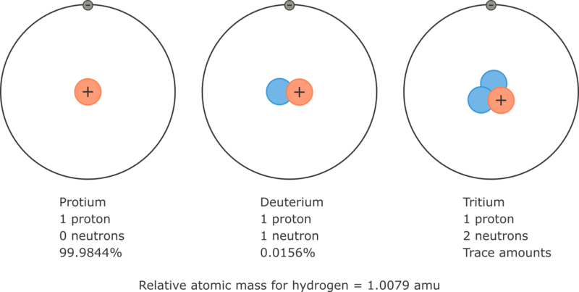
The relative atomic mass is the average mass number of an element.
The isotopes of an element each have slightly different mass numbers, and occur in different abundances in nature. The relative atomic mass is a calculated average of the mass numbers for all the isotopes of that element. It can also be called the atomic weight.
Being a calculated average, the relative atomic mass is usually not a whole number. This is the value displayed on the periodic table alongside the atomic number.

Slide 14

To find the number of neutrons in an atom, subtract the atomic number from the mass number:
When working this out from the information given on the periodic table, simply round the atomic mass to the nearest whole number. This will give you the mass number of the most abundant isotope of that element.
For example, the relative atomic mass of lithium is 6.94. We can round this to 7, the mass number of the most abundant lithium isotope. The atomic number of lithium is 3.

Slide 15
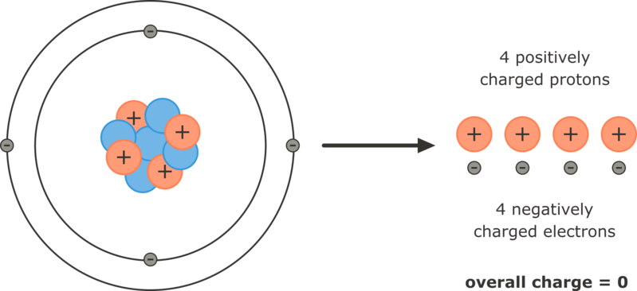
Atoms are electrically neutral, which means they have no charge overall.
This means that the number of electrons (-) in a neutral atom is always equal to the number of protons (+). Therefore, the atomic number also tells you how many electrons an atom of that element has.

Slide 16
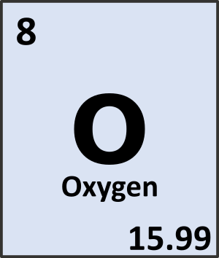
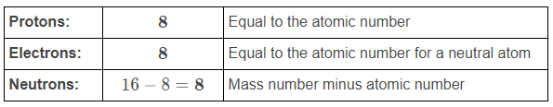
You may need to work out the number of subatomic particles in an atom from the information provided on the periodic table. For example, the element box for oxygen is shown to the right. How many protons, neutrons and electrons are there in a neutral atom of oxygen?
Solution:
From the element box, we can see that the atomic number of oxygen is 8, and the relative atomic mass of oxygen is 15.99. We can round the atomic mass to the nearest whole number, 16, to find the mass number, and then use this to determine the number of each subatomic particle.

Slide 17
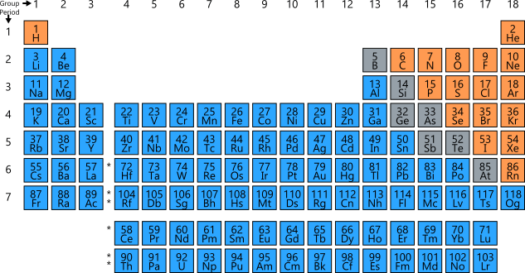
Usually, the atomic number of an element is written at the top of its box on the periodic table and the atomic mass is written at the bottom. However, some periodic tables write them the other way around.
The important thing to remember is that the atomic mass is the larger, decimal number and the atomic number is the smaller number that is always an integer. If only one number is shown, it will be the atomic number, like in the periodic table shown below.

